Slide 1

G2M Insight for Cab Investment
Firm
10/21/2022

Slide 2
Agenda
Executive Summary
Problem Statement
Approach
EDA
EDA Summary
Recommendations

Slide 3
Executive Summary
XYZ is a private firm in US.
Due to remarkable growth in the Cab Industry in last few years and multiple key players in the market, it is planning for an investment in Cab industry.
As per their Go-to-Market(G2M) strategy they want to understand the market before taking final decision.

Slide 4
Approach
Exploratory Data Analysis (EDA) will be conducted to help XYZ firm decide which company to invest in.
1) Data will be opened and read
2) Data will be preprocessed and optimized for visualization
3) Statistical data analysis will be executed for several hypothesis
4) General conclusion will be made with suggestions for XYZ firm

Slide 5
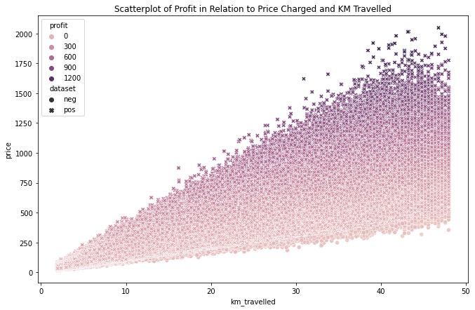
Negative Profit
Negative profit trends linearly towards the bottom.
Because of this pattern, the prices were most likely set this way as discounts to promote the business.

Slide 6
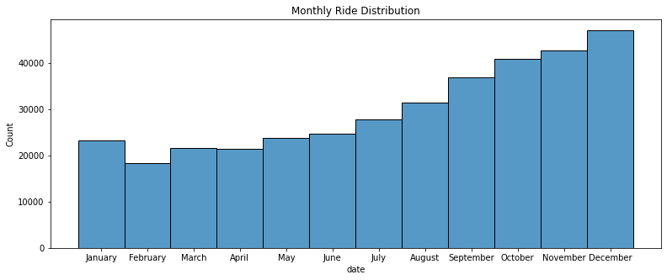
Monthly Ride Distribution

Slide 7
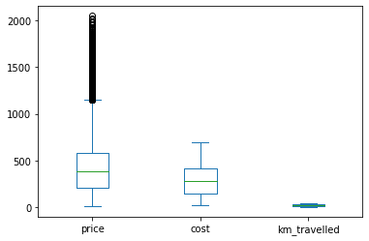
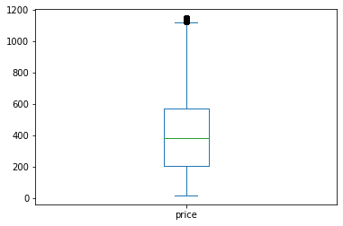
Outlier Removal
Initial Distribution
Outliers Removed

Slide 8
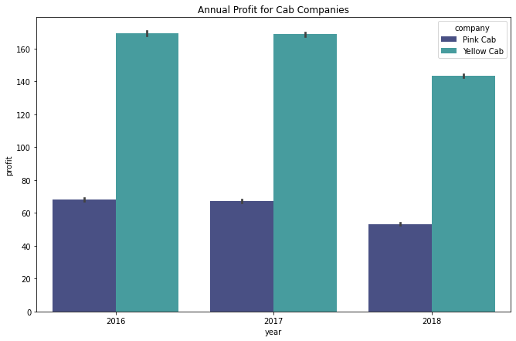
Annual Profit
Yellow Cab outperforms Pink Cab for each yearly profit

Slide 9
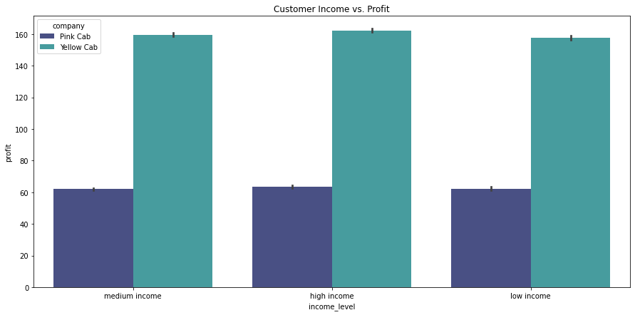
Customer Income vs Profit
Yellow Cab makes the most profit in all income categories

Slide 10
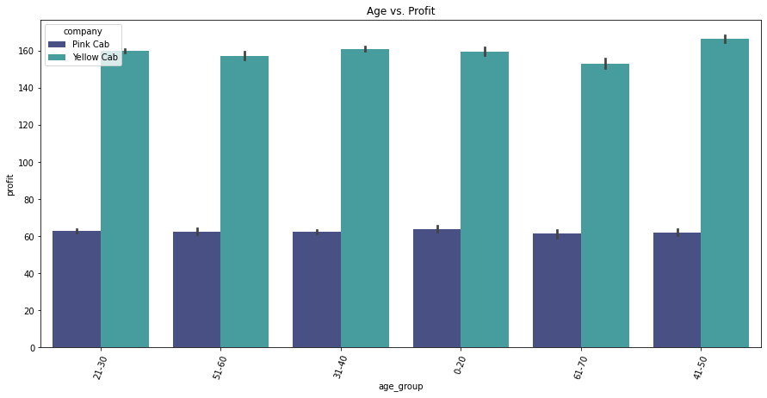
Age vs. Profit
Yellow Cab outperforms Pink Cab in all age categories.

Slide 11
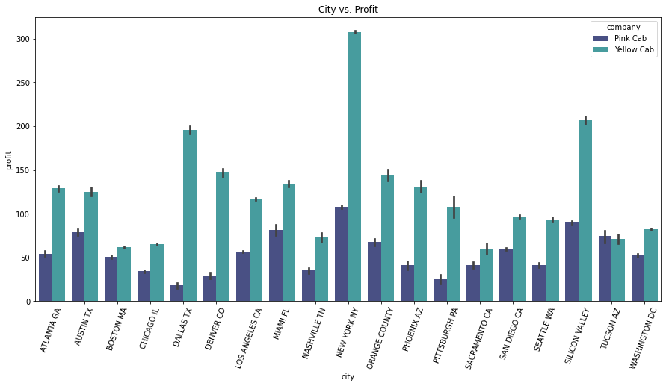
City vs Profit
Yellow Cab earns the most profit in all cities as well, with the exception of Tucson AZ.

Slide 12
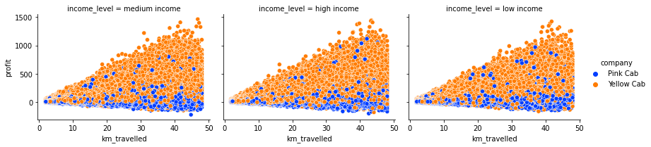
Income, KM Travelled, Profit
As the distance increases, Pink Cab tends to stay at the same profit level
Conversely, Yellow Cab’s profit margin increases as distance is increased.

Slide 13
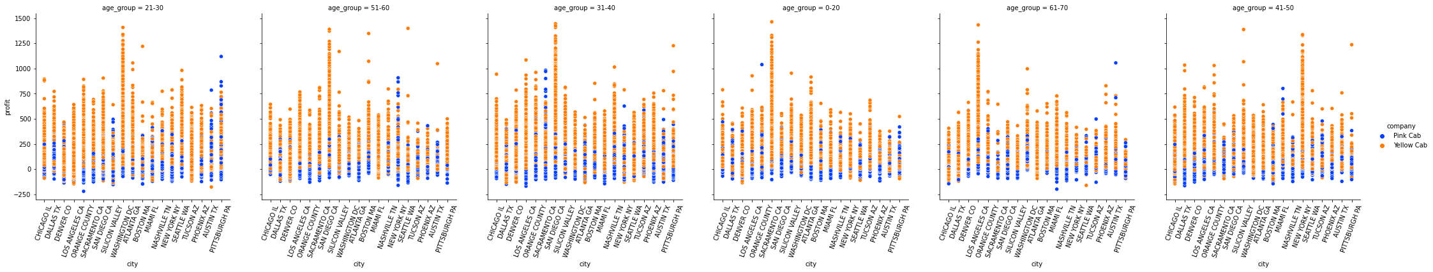
Profit, Age, City

Slide 14
Summary & Recommendations
The Yellow Cab company outperforms Pink Cab in every analysis.
XYZ Firm should invest in Yellow Cab
Pink Cab may be newer and just starting the business. It is worth keeping analyzing in the future.

Slide 15
Thank You

